Slide 1
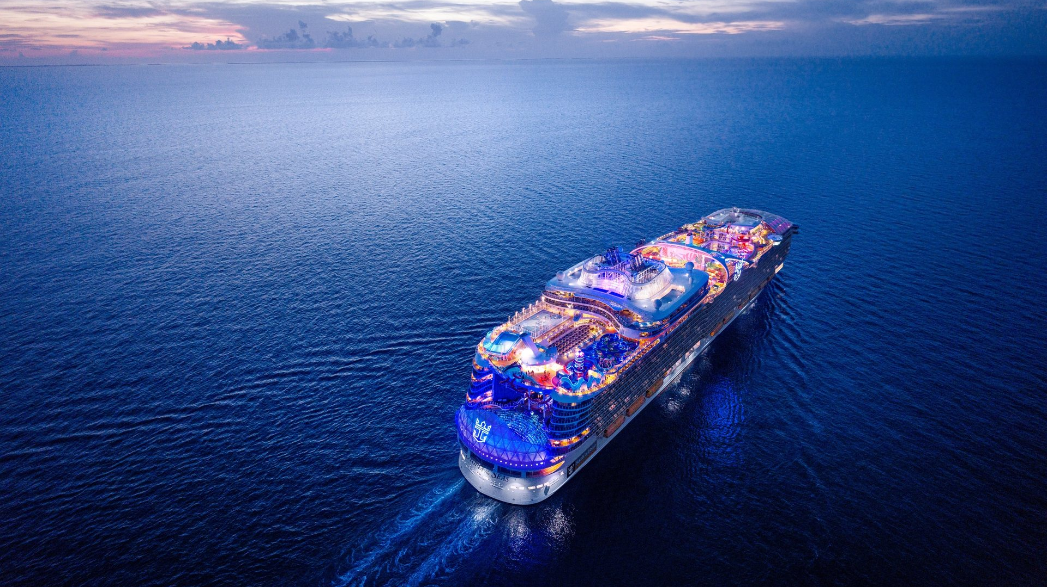
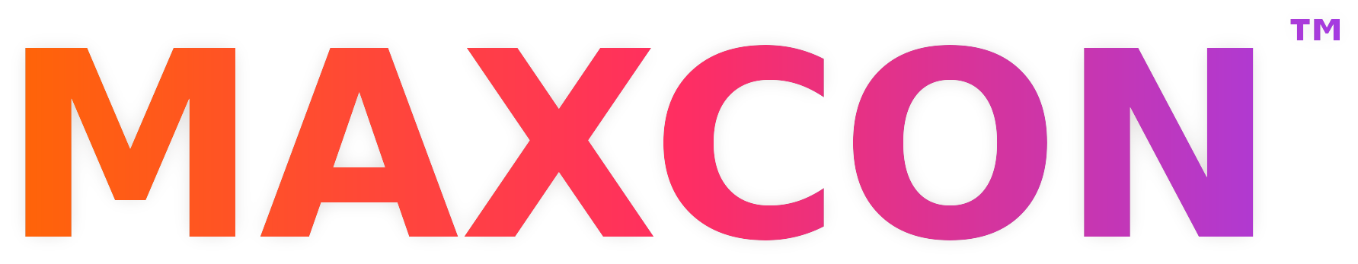
Maximo Sessions Preview
HOSTED BY LIQUID ENTERPRISE
April 5–9, 2027 · Utopia of the Seas · Port Canaveral to the Bahamas
Notes:
Welcome, everyone, and thanks for joining. I'm Scott Geller, and I host MAXCON under the Liquid Enterprise brand. If you're running Maximo today, or you're curious about where Maximo and Maximo Real Estate and Facilities are headed, this hour is for you. Today is a preview of the Maximo sessions on the MAXCON agenda and the people delivering them. MAXCON sails April 5 through 9, 2027, aboard Utopia of the Seas, from Port Canaveral to the Bahamas.

Slide 2
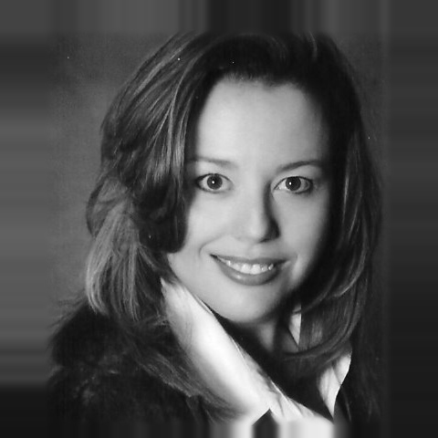
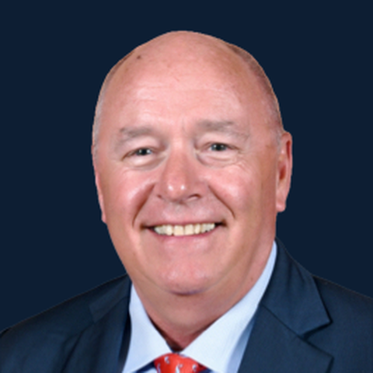
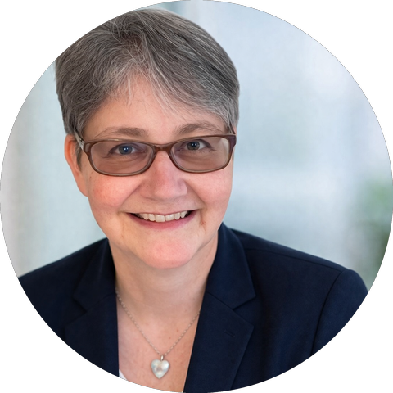
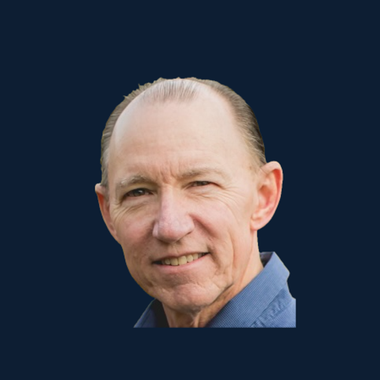
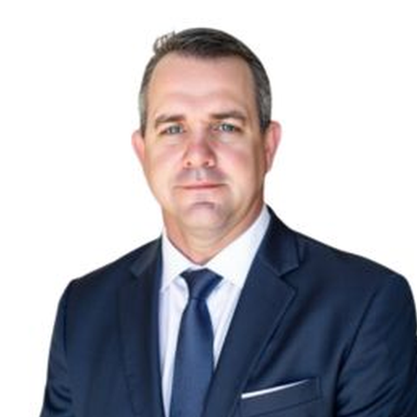
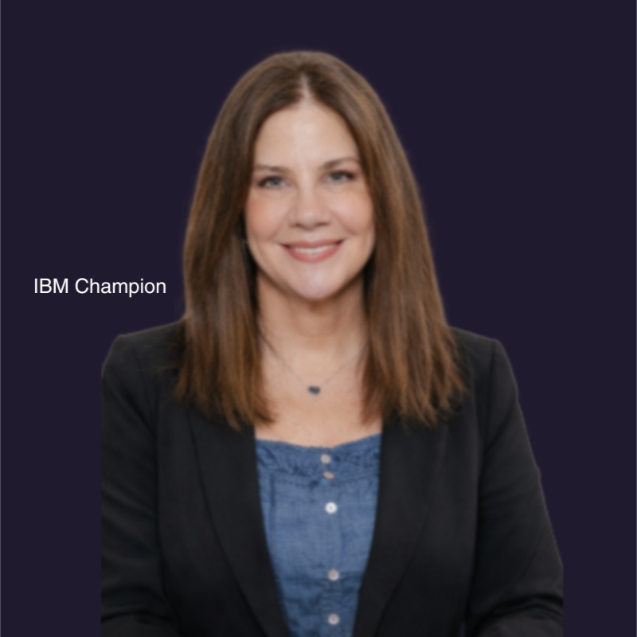
Meet the presenters
Lisa Stuckless
John Connell
Anne Antonelli
Principal Product Manager
CEO
Founder
IBM
JFC & Associates
Technology Training & Consulting
Maximo Real Estate & Facilities
Digital twins and asset infrastructure SME
25+ years; 2025 Maven User Choice Award
Chris Framel
Karson Wynne
Julie Rampello
Founder and CEO
CEO
Founder
Snowheights Consulting
EAM Specialists
MAX Content Solutions
BI & Analytics SME
IBM Champion; former GSA Region 8 Maximo Program Manager
IBM Champion
MAXCON™ 2027 · liquidenterprise.com/maxcon
Notes:
Today, I'm joined remotely by an esteemed panel of presenters and team members who have been working tirelessly to make this event a success. I'd like to introduce you to Lisa Stuckless from IBM, John Connell from JFC & Associates, Anne Antonelli from Technology Training & Consulting, Chris Framel from Snowheights Consulting, Karson Wynne from EAM Specialists and last, but certainly not least, Julie Rampello from MAX Content Solutions.

Slide 3
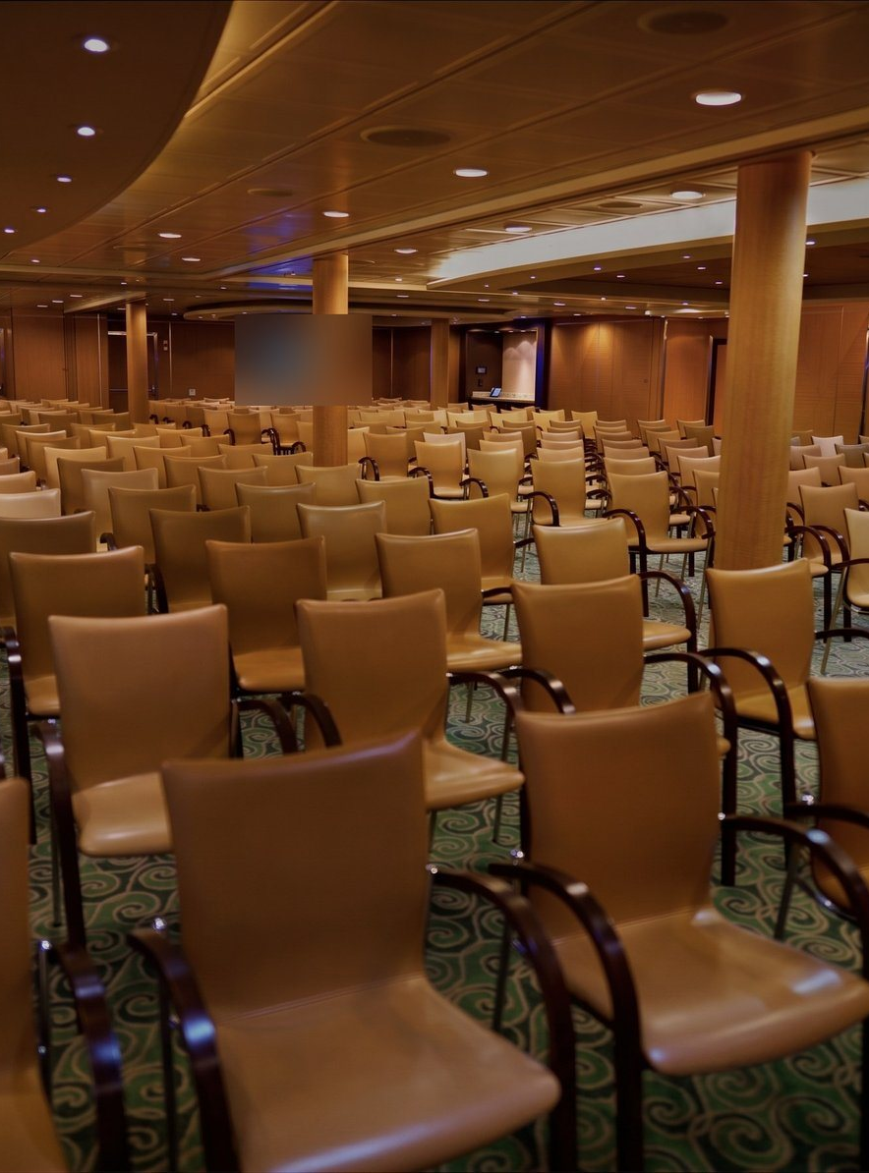


Before we start
HOUSEKEEPING
Ask questions anytime
Drop them in the monitored chat. We'll take a dedicated Q&A at the end.
Details are online
Format, pricing, and hotel blocks are all at liquidenterprise.com/maxcon.
MAXCON™ 2027 · liquidenterprise.com/maxcon
Notes:
Two housekeeping notes before we start. First, questions are welcome throughout. Drop them in Q&A. It's monitored, and we'll answer them toward the end of our session. Second, if you haven’t yet, I encourage you to visit our site, liquidenterprise.com/maxcon. It contains a lot of information, everything from pricing, registration and blocks of hotel rooms to session information live on the MAXCON website.

Slide 4
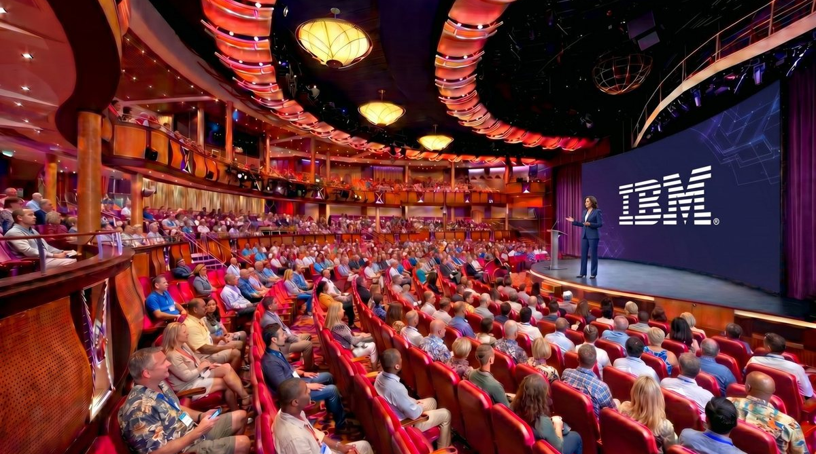
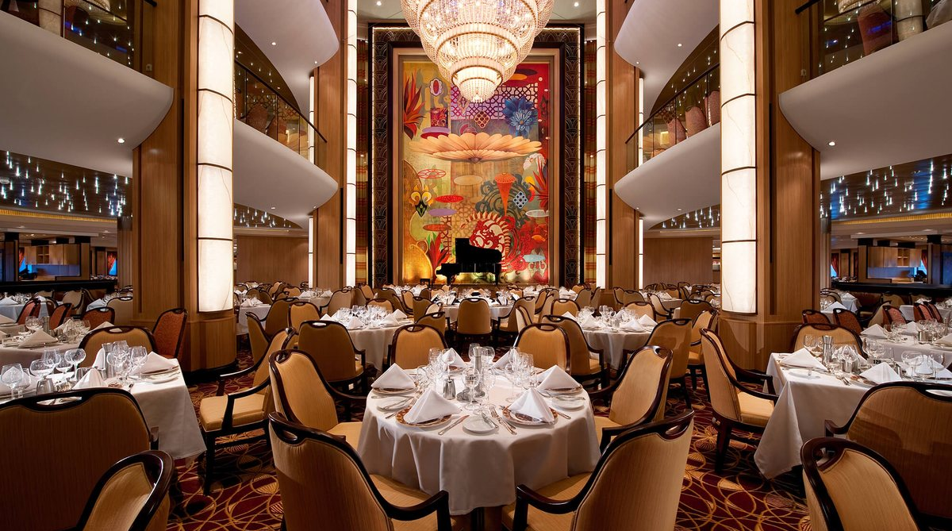
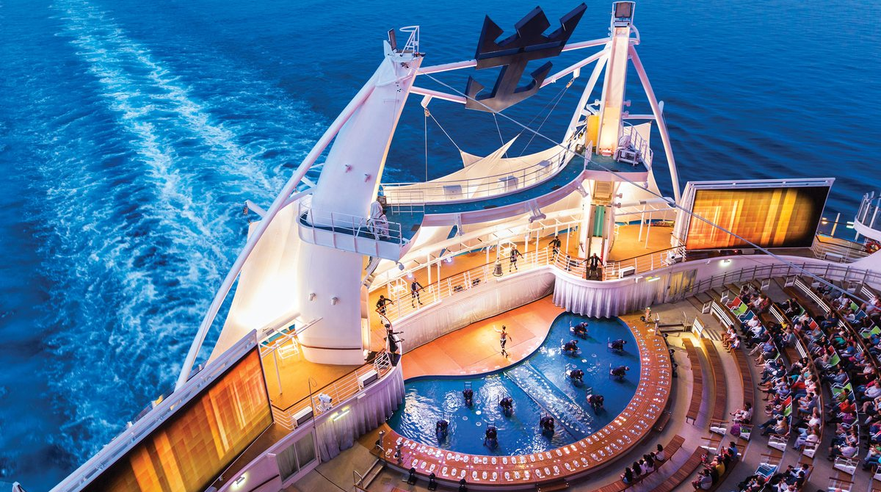
MAXCON is the union of the things I enjoy most about this job.
THE GENESIS OF MAXCON
WORK
FOOD
ENTERTAINMENT
Working with customers to solve complex problems in ways they may not have considered.
Those who know me know I love to cook. And eat.
And I love to entertain.
MAXCON™ 2027 · liquidenterprise.com/maxcon
Notes:
MAXCON is the union of the things I enjoy most about what I do. Work: I get to work with some of the best companies and organizations in the world. I get to understand the business behind the companies and some of the unique challenges that they’re facing. I get to work with teams to come up with solutions, sometimes these are not technical, but rather process related solutions. Also, those who know me, know that I love to cook and entertain (and that, unfortunately, also means I love to eat).

Slide 5
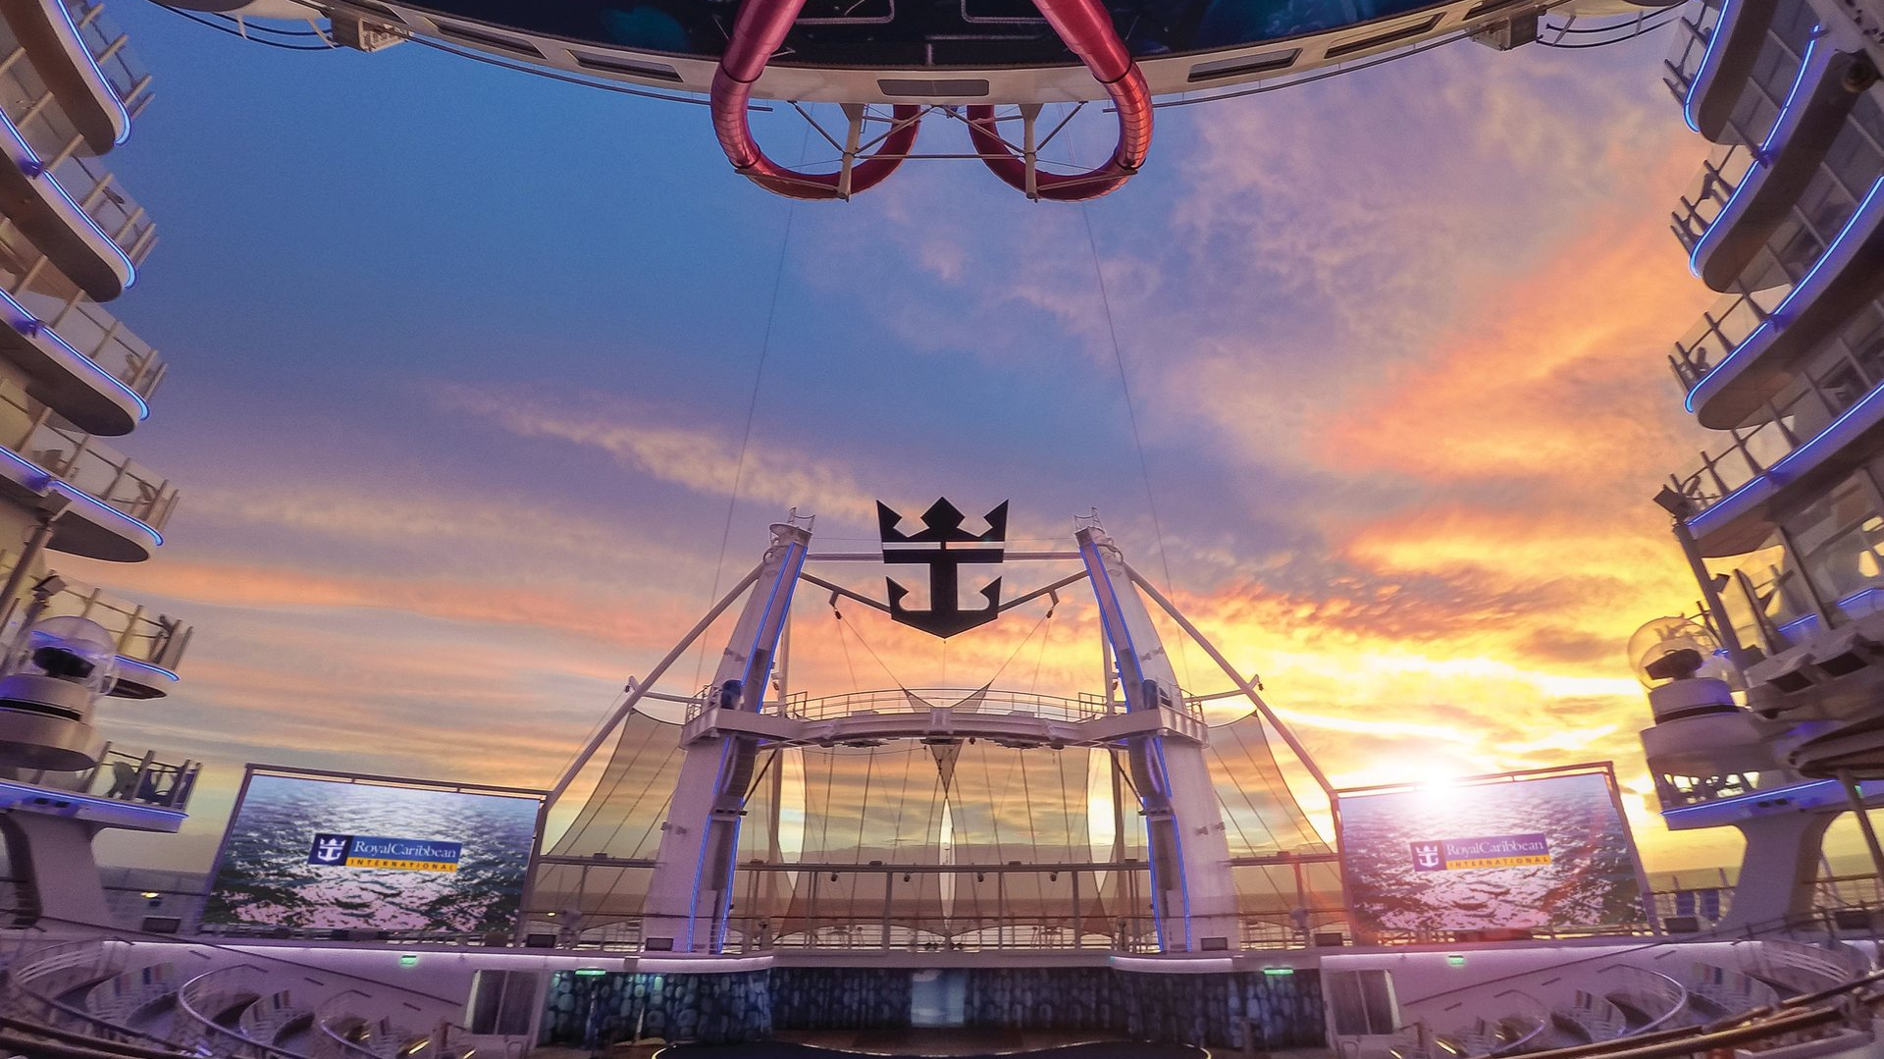
The perfect mix of work, food and entertainment, included in the price of your registration.
WHY A SHIP
DAYTIME
EVENINGS
IN BETWEEN
Breakout sessions, with lunch and “me time” built in.
Dinner and entertainment across multiple venues.
Plenty of time to catch up on work and take the can't-miss meetings.
Notes:
And that brings us to the ship. Putting this event on a cruise ship gives us the perfect mix of work, food and entertainment, and all of it is included in the price of your registration. The days look like a conference: breakout sessions, with lunch and some "me time" built in. The evenings look like a night out: dinner and entertainment across multiple venues. And in between, there's plenty of time to catch up on work and take those can't-miss meetings.

Slide 6
A day at MAXCON
Royal Theater
Voyager
Quantum
Freedom
Main Dining Room
8:00 AM
General session
9:00 AM
10:00 AM
Session 1
Session 3
Certification prep
9:30–11:00
9:30–11:00
Full-morning workshop
11:00 AM
Session 4
Session 2
12:00 PM
1:00 PM
“Me” time
2:00 PM
12:00–3:00 PM
3:00 PM
All aboard · 3:00 PM
4:00 PM
Session 5
Session 7
Session 8
Session 6
3:30–5:30
3:30–5:30
5:00 PM
6:00 PM
7:00 PM
Dinner
6:30 PM
MAXCON™ 2027 · liquidenterprise.com/maxcon
Notes:
A more detailed view of a day at MAXCON™ looks like this. AM sessions run from (approximately) 8:00 AM – (approximately) Noon. We open the day in the main theater with our general session. General sessions may be a roadmap on one-day and an ask the experts on another. Mid-day is that built-in "me time," from noon to 3:00. Grab lunch, take a few meetings, go to the gym, relax by the pool, take. a walk on or off the ship or go back and relax in your cabin. All aboard is at 3:00, and the afternoon breakouts run from 3:30 to 5:30. Choose to enjoy dinner and networking with other attendees or go off on your own. Your evening is yours to enjoy and you can do it without the need for an expense report.

Slide 7
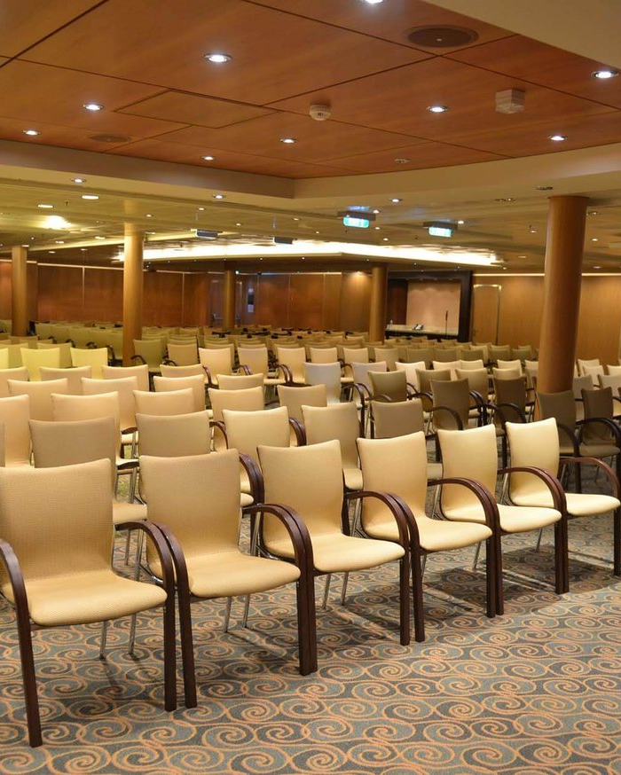

A more exclusive event, built around longer, deep-dive sessions and hands-on training.
SESSIONS AT MAXCON
The roadmap session is part of the morning general session everyone attends, so you won't miss it.
Sessions for everyone, regardless of your role.
A balanced, memorable learning experience you'll look forward to year over year.
Notes:
At MAXCON, sponsors teach. They're there to provide valuable insight, and they get to show off their solutions in sessions, not from behind a booth.
It’s our goal to create a more intimate event, focused on longer, deep-dive sessions and hands-on training rather than :30 minute pitch decks.
For those attendees who want to be less hands-on and are more strategy-focused, we have sessions for you as well.
Regardless of your role, we’ve built a balanced, memorable and enjoyable experience that you'll look forward to year over year.
And now I’d like to turn this over to John Connell. John..

Slide 8
Making the case
Per attendee | MAXCON 2027 | Other conferences
Registration | $3,750 | $1,800–$2,700
Hotel | $250 (1 night) | $1,400–$1,500
Meals | Included | $200
Evening events | Included | $150
Total per attendee | ~$4,000 | $4,300–$4,550
Fixed cost, no overruns
Cabin, meals, Wi-Fi, conference and evening events are included.
Teams of 5+ pay $3,400/seat
$350 less per person than the standard $3,750 rate.
Per attendee, excluding airfare. Other-conference hotel reflects rates attendees paid at recent comparable events.
MAXCON™ 2027 · liquidenterprise.com/maxcon
Notes:
Now the part your manager is going to ask about. One invoice covers registration, your cabin, meals, Wi-Fi, the sessions, and gratuities. It's a fixed cost with no overruns. Line it up against a typical conference. Registration there runs $1,800 to $2,700. Then $1,400 to $1,500 for the hotel, plus meals and evening events on top. MAXCON is $3,750, plus one night of hotel near the port. Call it $4,000., against $4,500 for comparable conferences, both excluding airfare. And if you're bringing a team, five or more, registration drops down to $3,400 each. That's $350 less per person. if you have 2026 training budget you haven't used, this is a great place for it.

Slide 9
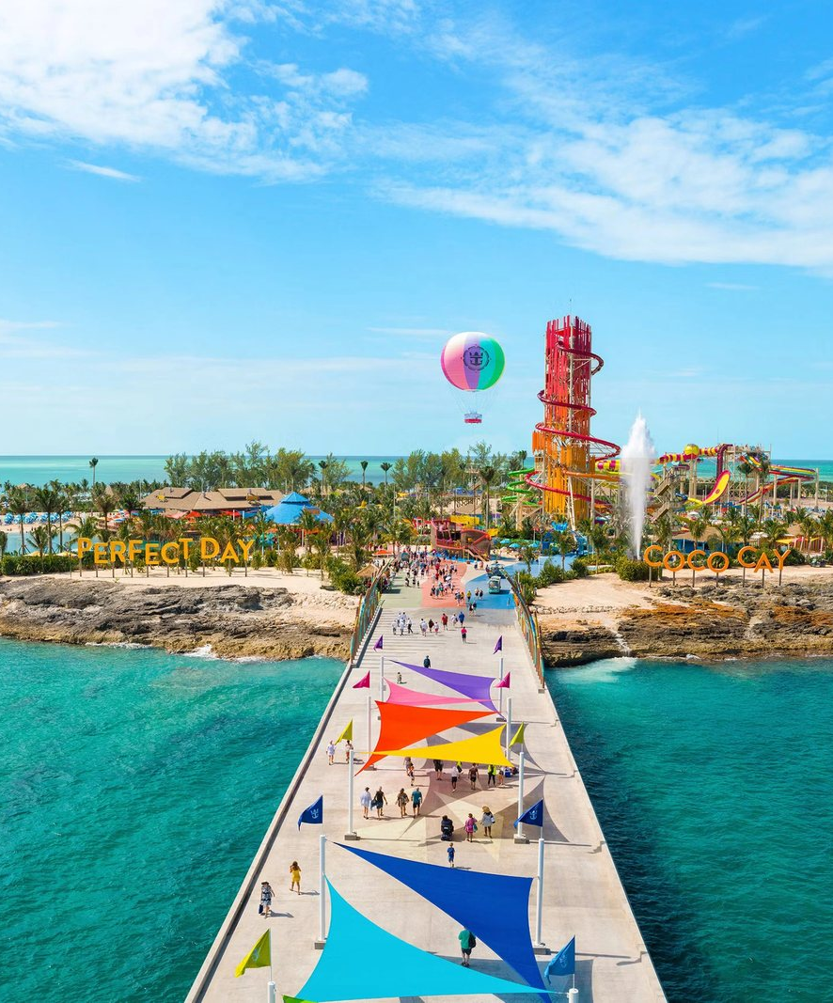
Reserve your spot
NEXT STEP
REGISTRATION CLOSES
Dec 18, 2026
liquidenterprise.com/maxcon
$3,750 per attendee, or $3,400 per seat for teams of 5+
Questions? maxcon@liquidenterprise.com
Notes:
By now, you've heard from a few of our experts, we've shown you that pricing is less than other conferences and You can leverage that use-it or lose-it 2026 training budget thanks to our immersive hands-on training sessions for both Maximo and MREF focused organizations. So head over to liquidenterprise.com slash maxcon and reserve your spot today. It's $3,750 per attendee, or $3,400 per seat for teams of five or more. Companion Registration is $700 and includes a shared ocean-view balcony cabin with the conference attendee, meals, entertainment, high-speed internet and a non-alcholic beverage package. Registration closes soon, on December 18th. If MAXCON is on your radar (and it should be), don't wait to lock it in. and don't hesitate to reach out to me or my team directly , if you'd like help making the case to your manager or if you have any questions. I can be reached at maxcon@liquidenterprise.com.

Slide 10
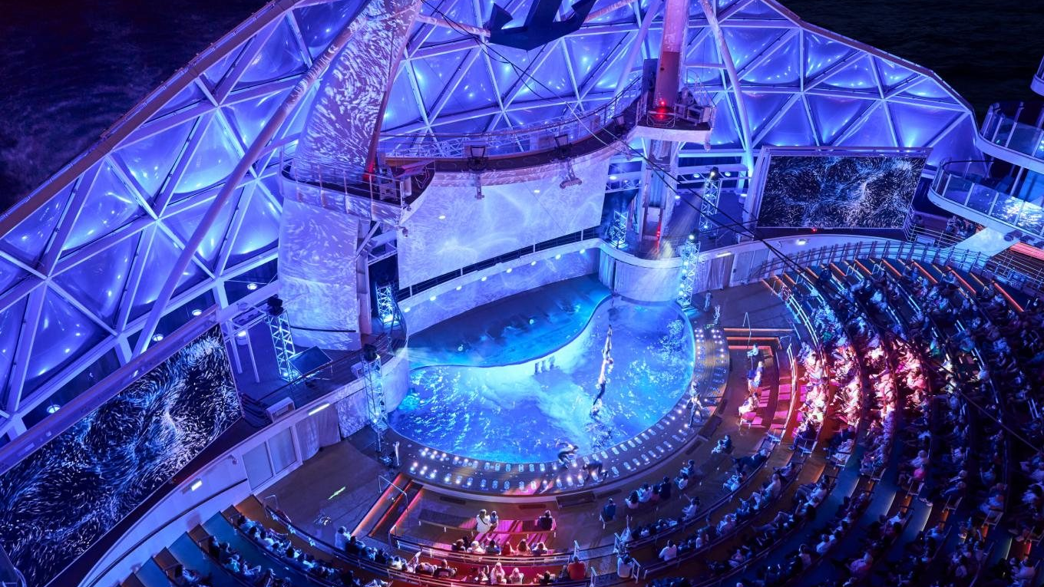
Questions?
GOOD TO KNOW
Registration closes Dec 18, 2026
General or sponsorship questions?
The sessions, migration timing, getting this approved. Anything at all.
Reach out to our team at MAXCON@liquidenterprise.com
liquidenterprise.com/maxcon
Notes:
Let's open it up. What questions can I answer?

