Slide 1
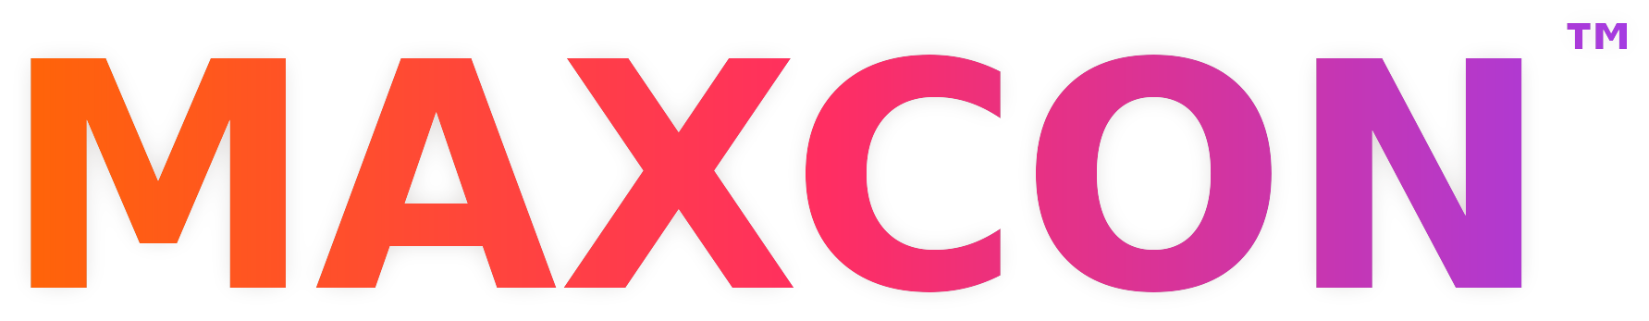
HOSTED BY LIQUID ENTERPRISE
From TRIRIGA to Maximo Real Estate & Facilities Sessions Preview
April 5–9, 2027 · Utopia of the Seas · Port Canaveral to the Bahamas
Notes:
Scott: Welcome everyone, thank them for joining. This session is aimed at anyone running TRIRIGA today or curious about Maximo Real Estate and Facilities. Introduce yourself and the panel briefly, then hand off per the agenda.

Slide 2


BEFORE WE START
Ask questions anytime
Details are online
Drop them in the monitored chat.
Dedicated Q&A at the end.
Format, pricing, and hotel blocks are all at liquidenterprise.com/maxcon.
MAXCON™ 2027
Notes:
Scott: Two housekeeping points. Questions are welcome throughout via chat, and we'll answer them in the Q&A at the end. Everything on format, pricing, and hotel blocks lives on the MAXCON website, so we'll keep today focused on the sessions and the people delivering them.

Slide 3
A DAY AT MAXCON
Royal Theater
General sessions
Voyager
Up to 110
Quantum
Up to 110
Freedom
Up to 80
Main Dining Room
Dinner
8:00 AM
General session
All attendees
9:00 AM
10:00 AM
Session 1
9:30–11:00
Session 3
9:30–11:00
Certification prep
Full-morning workshop
11:00 AM
Session 2
Session 4
12:00 PM
“Me” Time
12:00–3:00 PM
1:00 PM
2:00 PM
3:00 PM
All aboard · 3:00 PM
4:00 PM
Session 5
Session 7
3:30–5:30
Session 8
3:30–5:30
5:00 PM
Session 6
6:00 PM
7:00 PM
Dinner
6:30 PM
8:00 PM
MAXCON™ 2027
Notes:
Scott: One invoice covers registration, cabin, meals, Wi-Fi, sessions, and gratuities. Session hours are the same as any onshore conference. And unlike a sales call, this is IBM and its partners walking through the actual migration path.

Slide 4
MAKING THE CASE
 | MAXCON 2027 | Other conferences
Registration | $3,750 | $1,800–$2,700
Hotel | $250 (1 night) | $1,400–$1,500
Meals | Included | $200
Evening events | Included | $150
Total per attendee | ~$4,000 | $4,300–$4,550
Fixed cost, no overruns
Cabin, meals, Wi-Fi, Conference and evening events are included.
Teams of 5+ pay $3,400/seat
$350 less per person than the standard $3,750 rate.
Per attendee, excluding airfare. Other-conference hotel reflects rates attendees paid at recent comparable events
MAXCON™ 2027
Notes:
Scott: One invoice covers registration, cabin, meals, Wi-Fi, sessions, and gratuities. Session hours are the same as any onshore conference. And unlike a sales call, this is IBM and its partners walking through the actual migration path.

Slide 5



EVERYTHING ELSE
Format, pricing, and travel details live online, where they stay current.
Event format
Pricing & inclusions
Travel logistics & hotel blocks
Days, labs, and evenings at sea
Attendee, companion, team rates
Port Canaveral
How the days are structured, the dedicated MAXCON event space, and hands-on labs.
What one fee covers, companion passes, and the rate for five or more.
Pre-cruise hotel blocks near the port and arrival logistics.
liquidenterprise.com/maxcon
MAXCON™ 2027
Notes:
Scott: Rather than walk through every logistics detail, we've put it all on the MAXCON website: how the event is structured, pricing and what's included, and the hotel blocks near Port Canaveral for April 4 arrivals. It's kept current there, so that's the best place to check.

Slide 6
NEXT STEP
Reserve your spot
liquidenterprise.com/maxcon
$3,750 per attendee, or $3,400 per seat for teams of 5+
REGISTRATION DEADLINE
Dec 18, 2026
Questions?
maxcon@liquidenterprise.com
MAXCON™ 2027
Notes:
Scott: Two ways this closes - the calendar date, or the seats simply running out. Whichever comes first is it, so if MAXCON is on your radar, don't wait to lock it in.

Slide 7
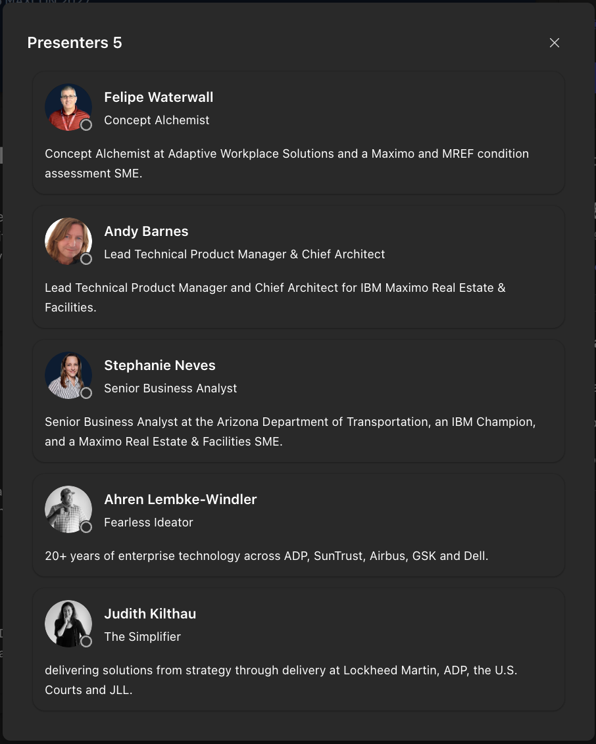
MEET THE PRESENTERS
Ahren Lembke-Windler
Judith Kilthau
Andy Barnes
Stephanie Neves
Felipe Waterwall
Fearless Ideator
The Simplifier
Chief Architect, MREF
Senior Business Analyst
Concept Alchemist
Llama
20+ years at ADP, SunTrust, Airbus, GSK, and Dell
Llama
Delivery at Lockheed Martin, ADP, U.S. Courts, and JLL
IBM
Lead Technical Product Manager
Arizona DOT
IBM Champion and MREF SME
Adaptive Workplace Solutions
Condition assessment SME
MAXCON™ 2027
Notes:
Scott: One invoice covers registration, cabin, meals, Wi-Fi, sessions, and gratuities. Session hours are the same as any onshore conference. And unlike a sales call, this is IBM and its partners walking through the actual migration path.

Slide 8
GOOD TO KNOW
Registration closes Dec 18, 2026
Questions?
General or Sponsorship Questions?
Reach out to our team at MAXCON@liquidenterprise.com
liquidenterprise.com/maxcon
Notes:
Scott: Open it up - "What questions can I answer? The sessions, migration timing, getting this approved, anything at all." For pricing, format, or travel questions, point people to liquidenterprise.com/maxcon. Close with a low-pressure next step: reach out to me directly if you'd like help making the case internally.

Slide 9







MREF SESSIONS ON THE AGENDA
Migration and Upgrades from TRIRIGA to MREF
Consolidated Maximo and MREF Roadmap
AI Lease Abstraction to Lease Accounting & Compliance
Andy Barnes, IBM
Lisa Stuckless + Andy Barnes, IBM
Stephanie Neves, Arizona DOT Andy Barnes, IBM
Hands-on Space Management Implementation
Introducing Event Management for Maximo
Beyond The Bubble: Adjacent Solutions for Manage & MREF
Judith Kilthau, Llama
Ahren Lembke-Windler, Llama
Lisa Stuckless, IBM
Making Condition Assessment Actually Work
Felipe Waterwall, AWS
MAXCON™ 2027
Notes:
Scott: Four of our speakers are joining us live today. Andy Barnes from IBM walks through TRIRIGA-to-MREF migration and the consolidated Maximo and MREF roadmap he co-presents with Lisa Stuckless, then joins Stephanie Neves from Arizona DOT on AI lease abstraction. Judith Kilthau and Ahren Lembke-Windler from Llama cover hands-on space management and event management. Lisa and Felipe Waterwall can't be with us today, so I'll walk through Beyond The Bubble and condition assessment myself.

